Slide 1

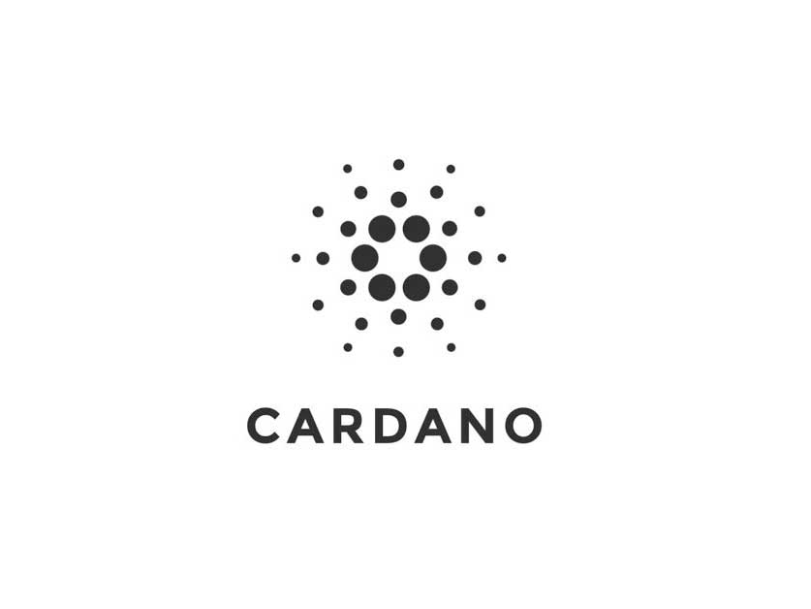
CaRDANO ADA BITCOIN Trend prediction using binance API
Group 6:
Benjamin COOPER
Mayank Kumar Pandey

Slide 2
Data
CARDANO BITCOIN HISTORICAL DATA
Fetched using binance API which is free for use and publicly available
266 rows of data and 7 features

Slide 3
Key Questions
Can we predict CARDANO BITCOIN price trend with these factors?
What models would be the most accurate in making these predictions?

Slide 4
Features
Variable | Data Type | Description
Time | DateTime64 | represents the timestamp of data when it was captured
Open | Object | tells us starting price of the bitcoin in a day
High | Object | tells us highest price of the bitcoin in that particular day
Low | Object | tells us lowest price of the bitcoin in that particular day
Close | Object | tells us closing price of the bitcoin in that particular day
Single_Day_Trend | int64 | difference between opening price and closing price of the bitcoin for a particular day
Two_Day_Trend | int64 | difference between closing price of this day and closing price of next day

Slide 5
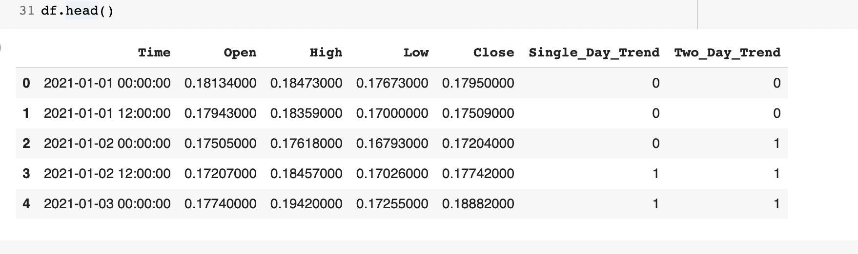
SAMPLE DATASET

Slide 6
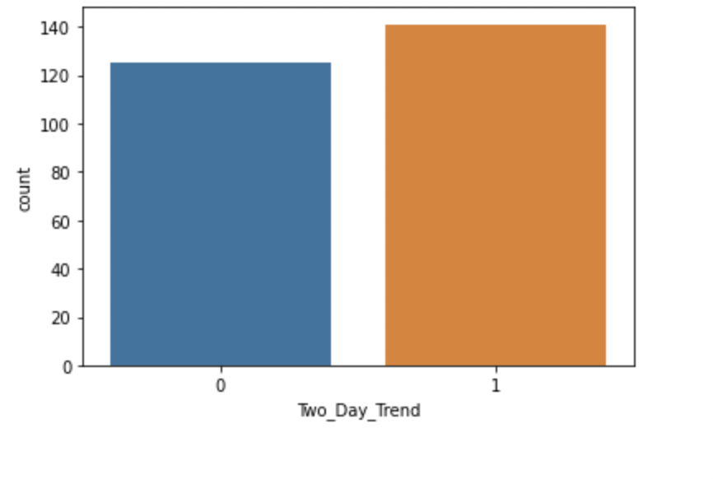
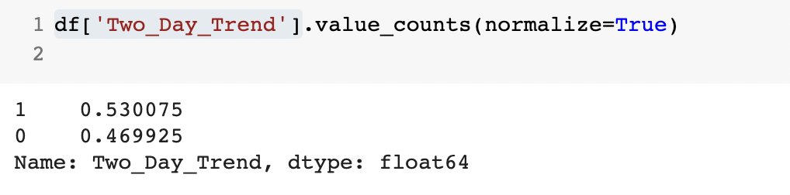
Exploratory Data Analysis

Slide 7
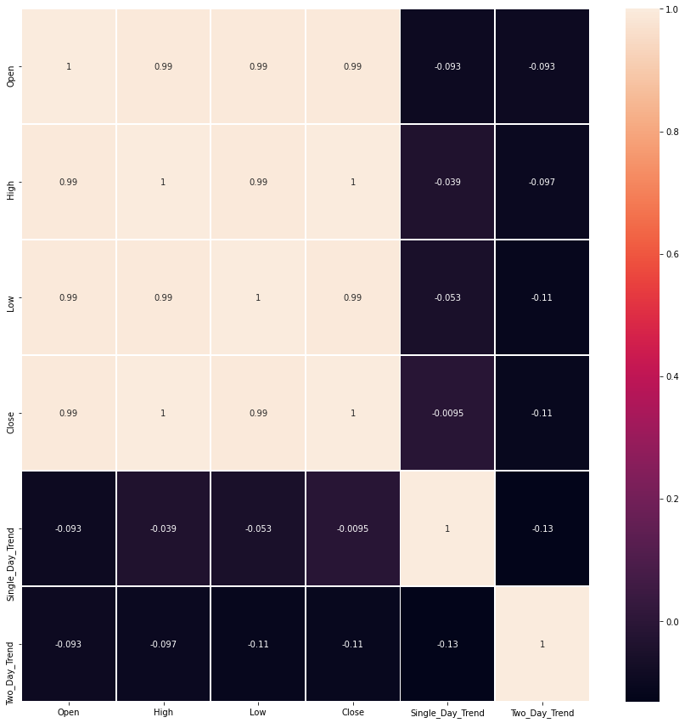
Exploratory Data Analysis

Slide 8
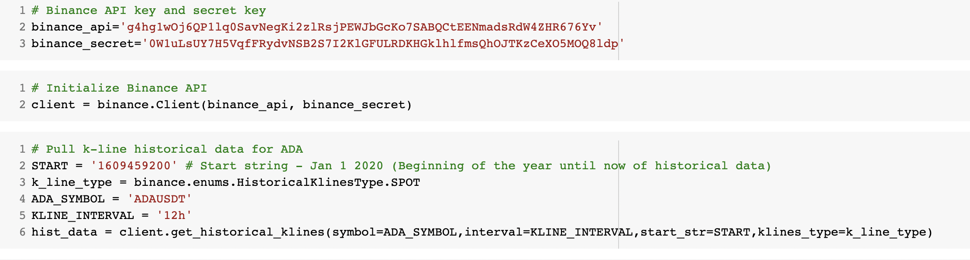
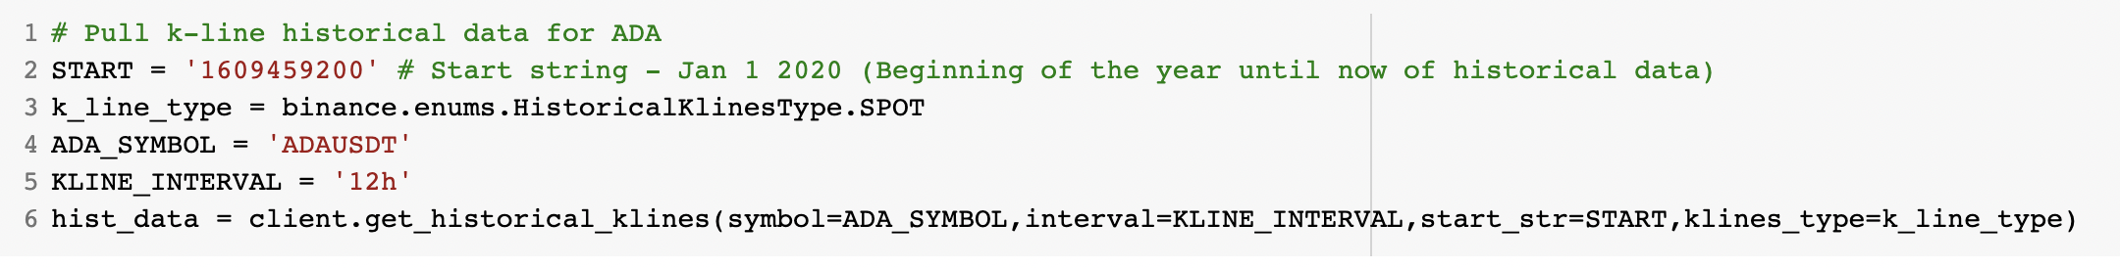
Feature Engineering
Notes:
Additionally, we encode the categorical features to be numerical values in order to run through our models. For example, the Satisfaction column is converted to 1 or 0, which represent satisfied or non-satisfied respectively. All remaining features are scaled.

Slide 9
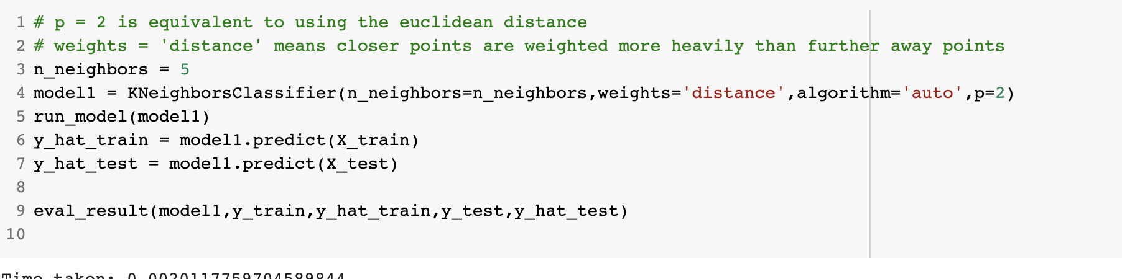
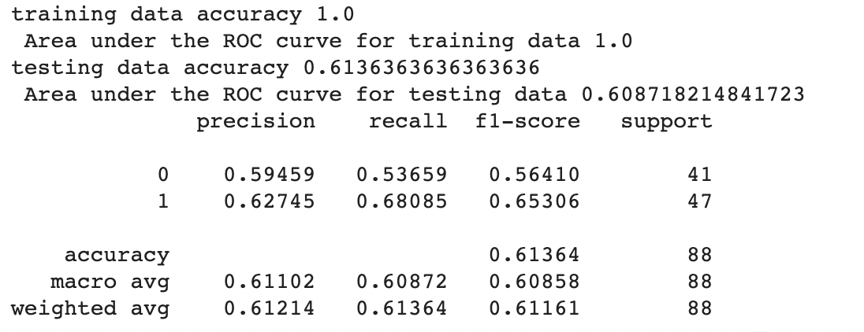
K nearest neighbor

Slide 10
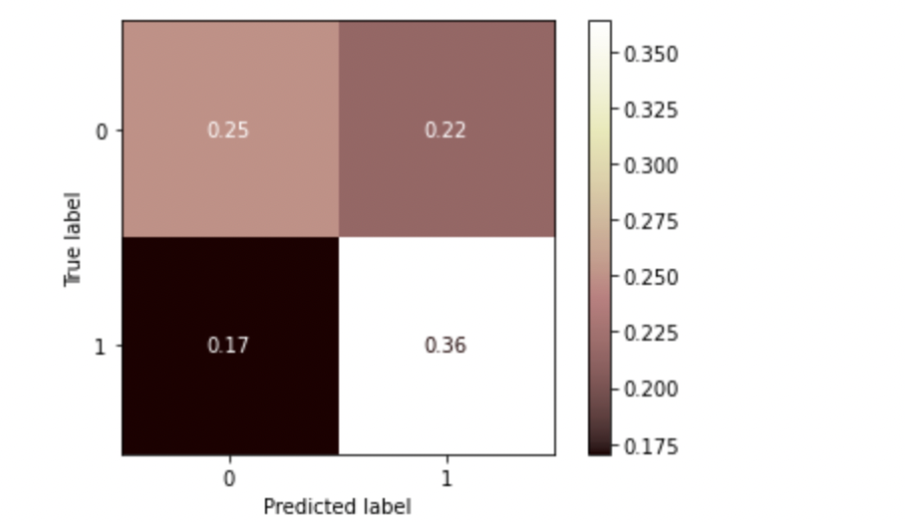
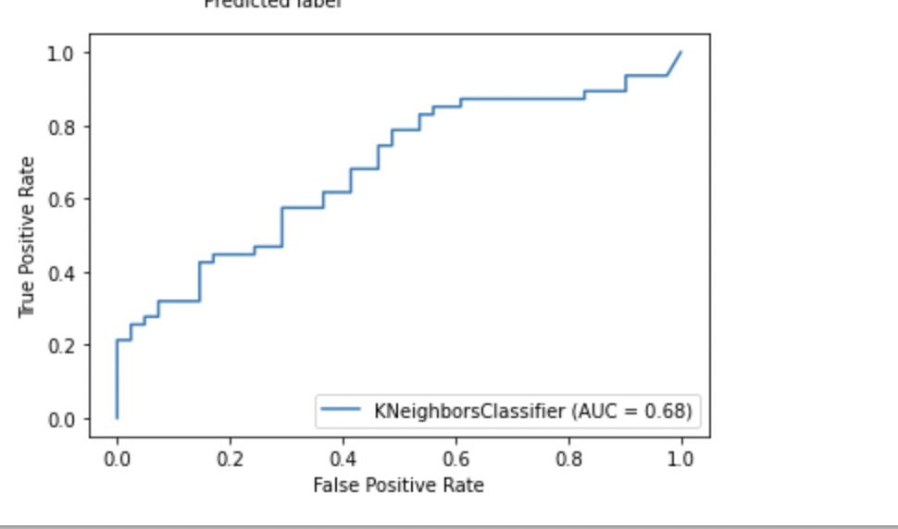
K NEAREST Neighbor

Slide 11

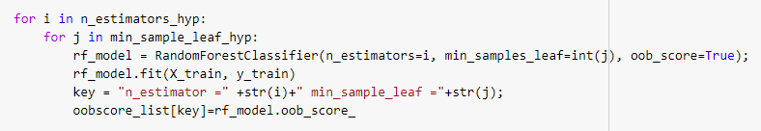
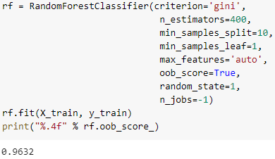
Random Forest

Slide 12
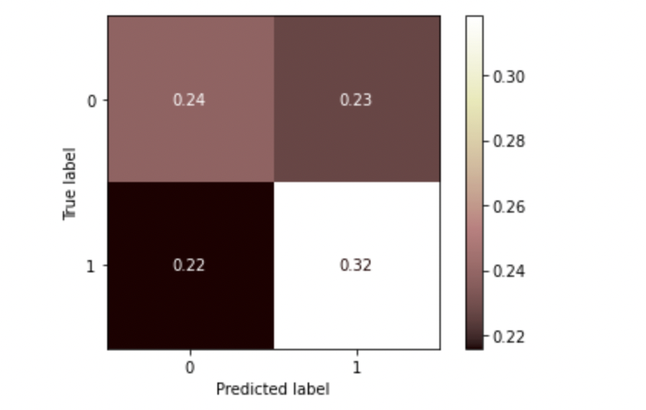
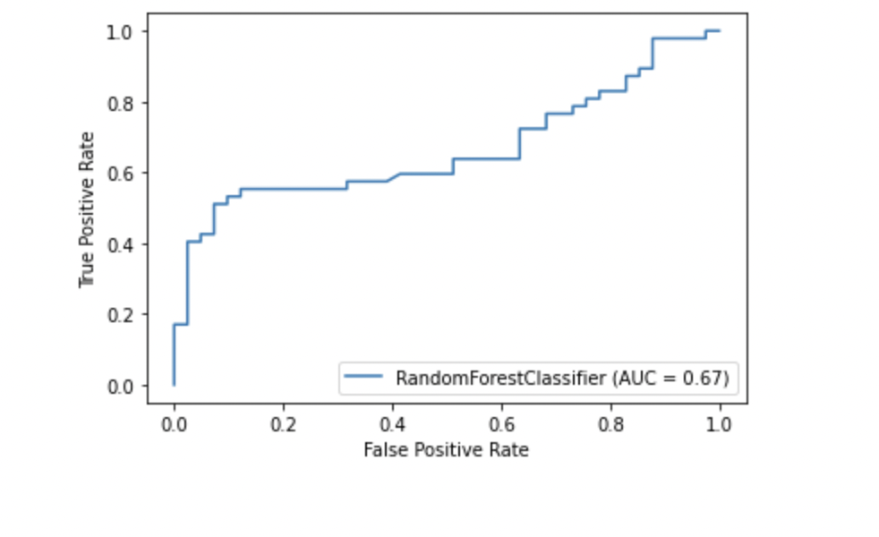
Random Forest

Slide 13

Model Comparison
 | Running time | Accuracy
KNN ALGORITHM | ~.002 seconds | 0.853
RANDOM FOREST | ~0.18 seconds | 0.929

Slide 14
Conclusion
Factors produced very accurate results (At least over 50% accuracy for all models)
Most Accurate Model: KNN algorithm
Fastest Model: KNN algorithm

